Slide 1
Network media types
Presentation By puja

Slide 2
Network Media Types
Communication transmits across a network on media. The media provides the channel over which the message travels from source to destination.
Modern networks primarily use three types of media to interconnect devices, as shown in the figure:
Metal wires within cables - Data is encoded into electrical impulses. Glass or plastic fibers within cables (fiber-optic cable) - Data is encoded into pulses of light. Wireless transmission - Data is encoded via modulation of specific frequencies of electromagnetic waves.

Slide 3
Twisted-Pair Cable
Ethernet technology generally uses twisted-pair cables to interconnect devices. Because Ethernet is the foundation for most local networks, twisted-pair is the most commonly encountered type of network cabling
In twisted-pair, wires are grouped in pairs and twisted together to reduce interference. The pairs of wires are colored so that you can identify the same wire at each end. Typically, in each pair, one of the wires is a solid color and its partner is the same color striped onto a white background.

Slide 4
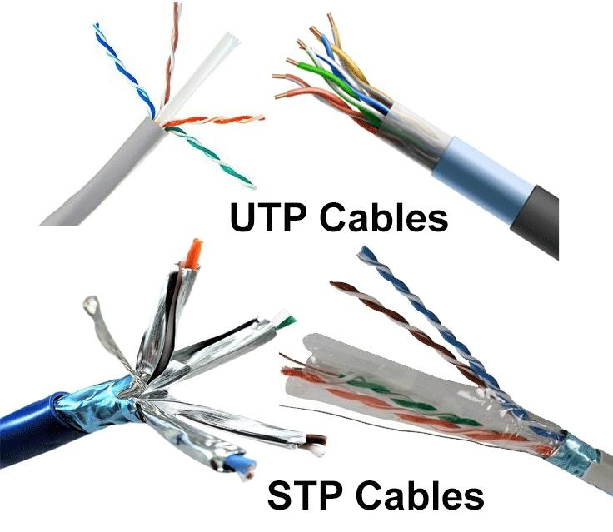
Twisted-Pair Cable

Slide 5
Coaxial Cable
Coaxial was one of the earliest types of network cabling developed. Coaxial cable is the kind of copper cable used by cable TV companies. It is also used for connecting the various components which make up satellite communication systems. Coaxial cable has a single rigid copper core that conducts the signal. This core is typically surrounded by a layer of insulation, braided metal shielding, and a protective jacket. It is used as a high-frequency transmission line to carry high-frequency or broadband signals.

Slide 6
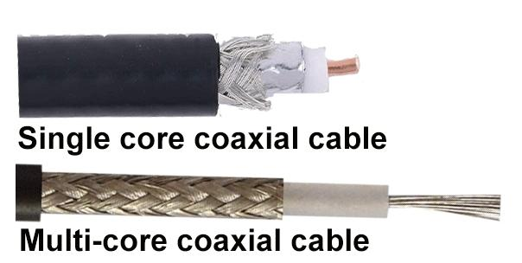
Coaxial Cable

Slide 7
Fiber-Optic Cable
Fiber-optic cable can be either glass or plastic with a diameter about the same as a human hair and it can carry digital information at very high speeds over long distances. Because light is used instead of electricity, electrical interference does not affect the signal. Fiber-optic cables have many uses as well as communications. They are also used in medical imaging, medical treatment, and mechanical engineering inspection
They have a very high bandwidth, which enables them to carry very large amounts of data. Fiber is used in backbone networks, large enterprise environments, and large data centers. It is also used extensively by telephone companies.

Slide 8
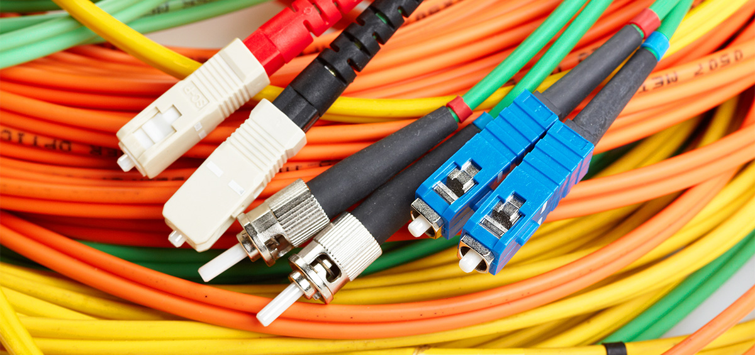
Fiber-Optic Cable

Slide 9
The four main criteria for choosing network media are these:
What is the maximum distance that the media can successfully carry a signal? What is the environment in which the media will be installed? What is the amount of data and at what speed must it be transmitted? What is the cost of the media and installation?

